Slide 1
My tasks in Trend Micro
Tianhe Gong
2016/10/14

Slide 2
Content
Configure and deploy phpMyFAQ
Case Migration Tool Project
Active/Inactive Users Tool Project
Write project documents
PPT of TestRail Introduction

Slide 3
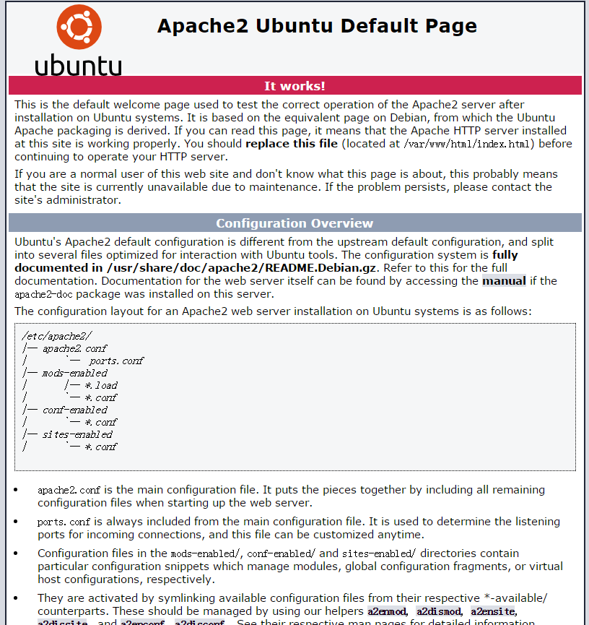
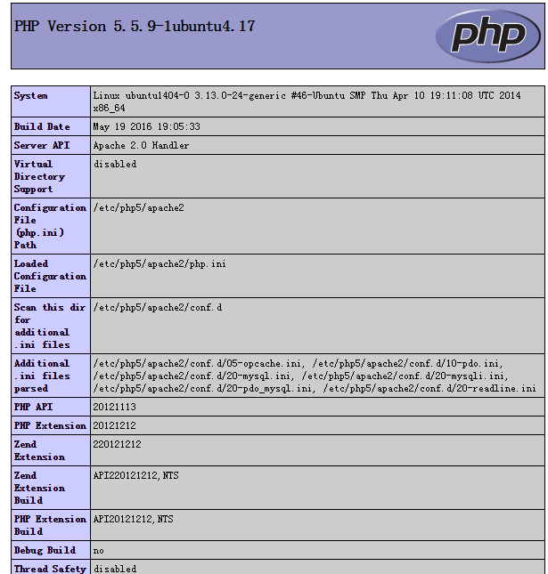
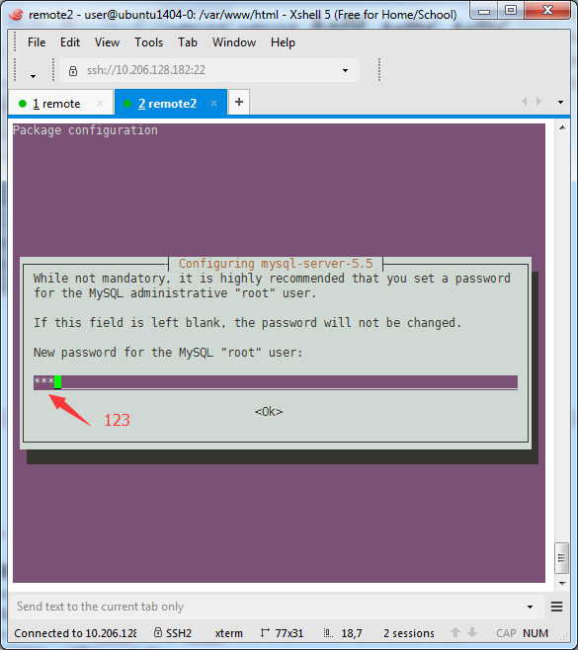
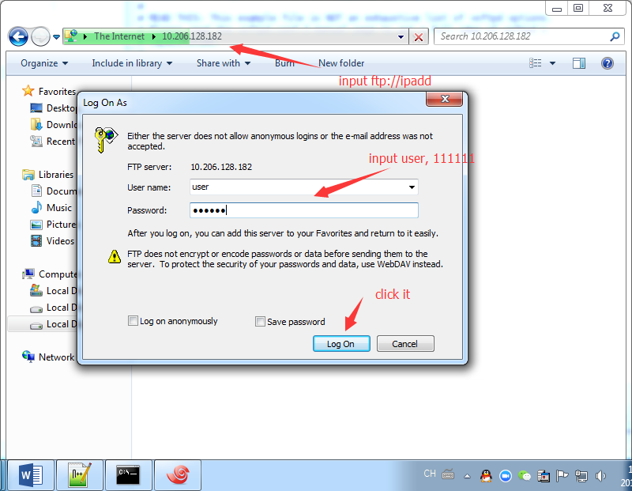
Configure and deploy phpMyFAQ
Environment Configuration:
1. Apache
2. PHP
3. MySQL
4. VSFTPD

Slide 4
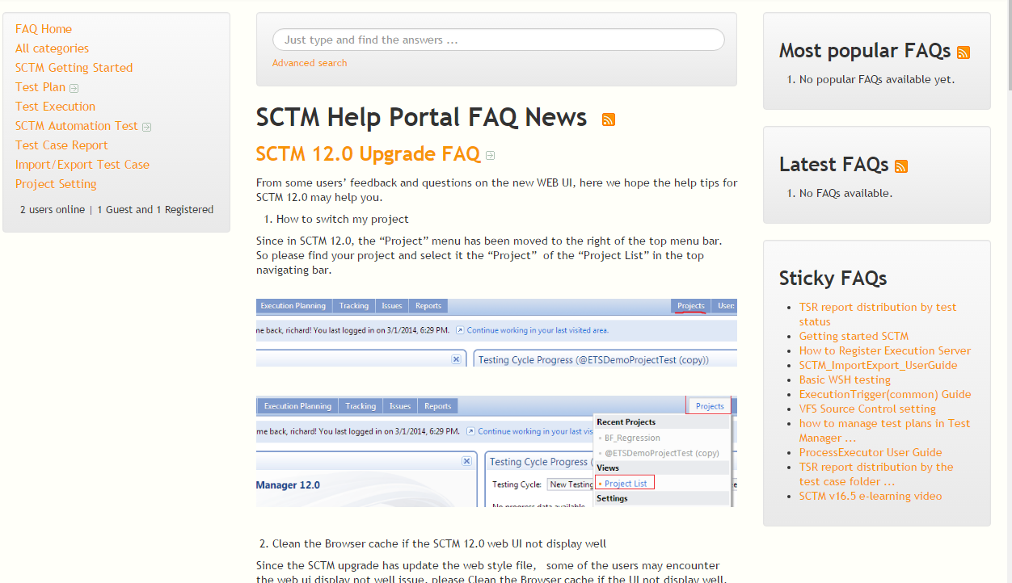
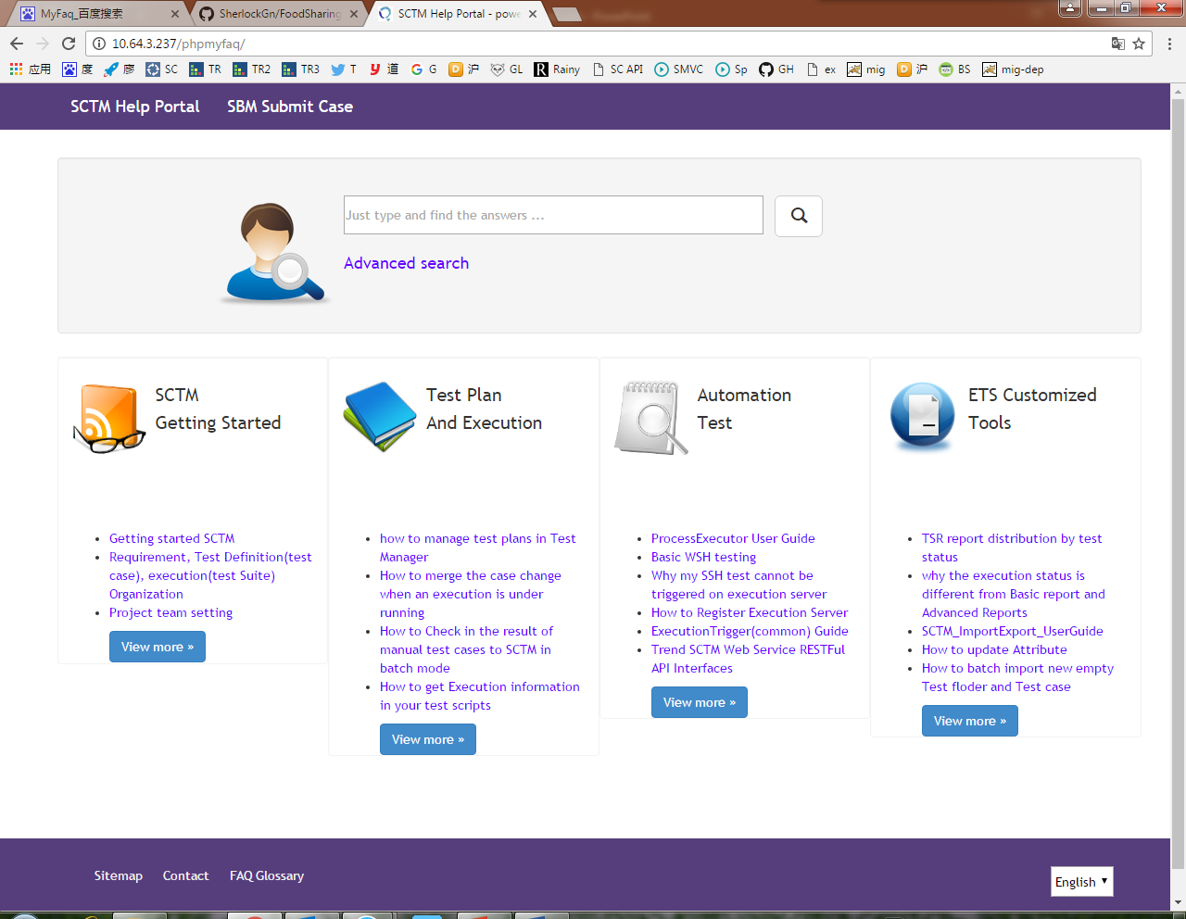
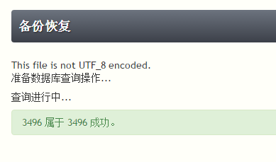
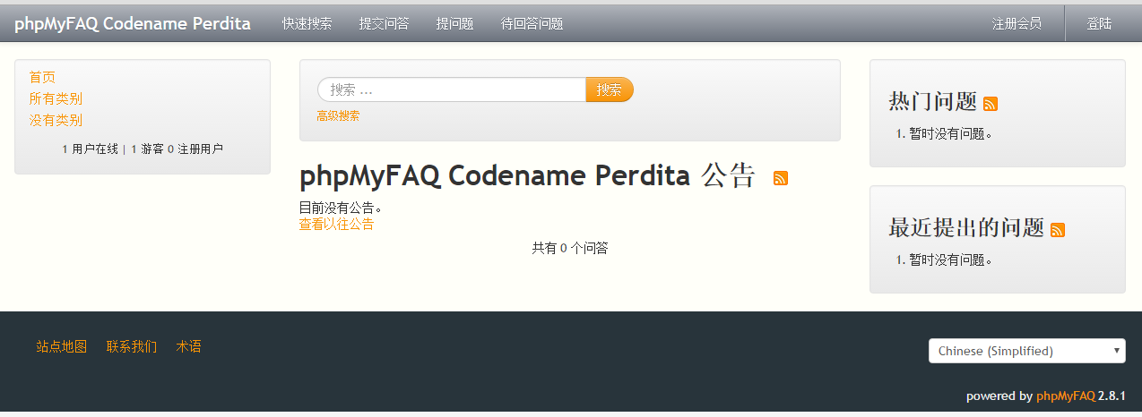
Configure and deploy phpMyFAQ
Install phpMyFAQ:
1. Initial project
2. Import Database
3. Style configuration in webpage
4. Add a new home page
5. Solve some problems caused by new home page

Slide 5
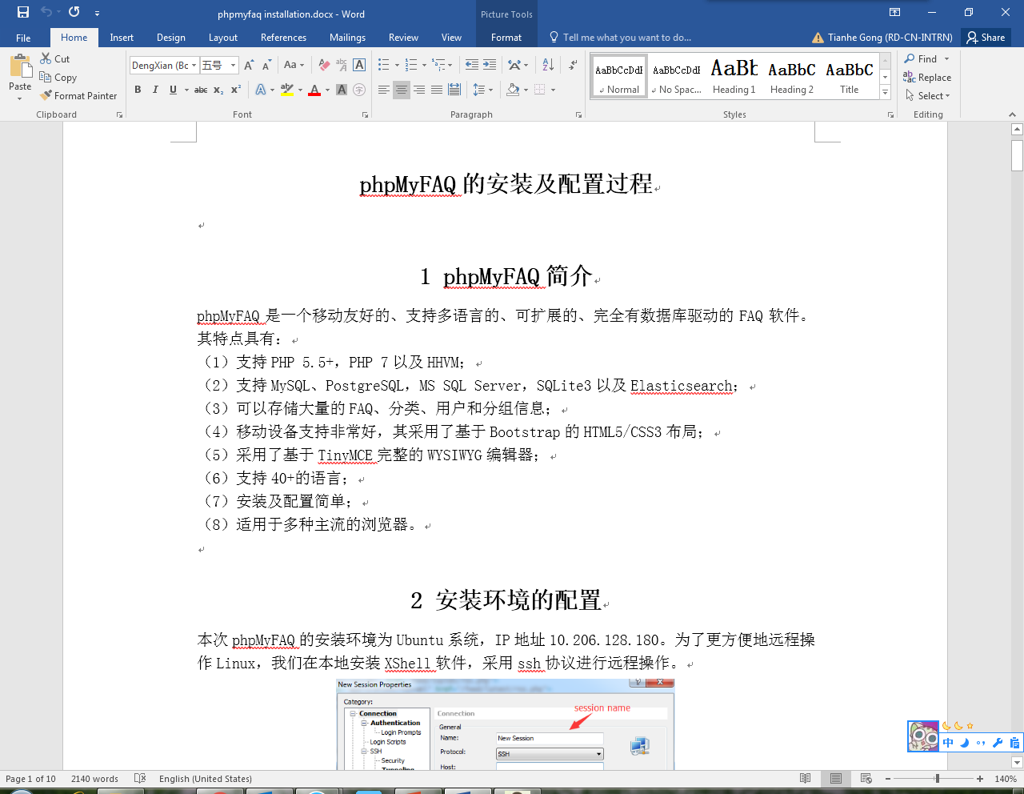
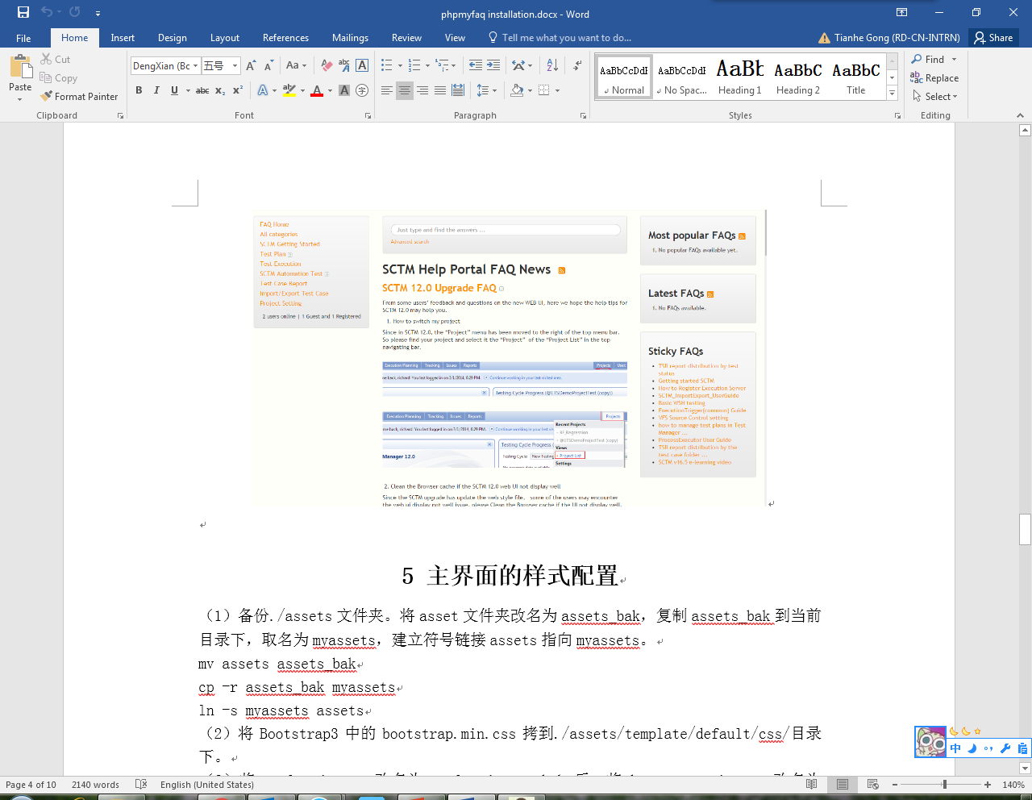
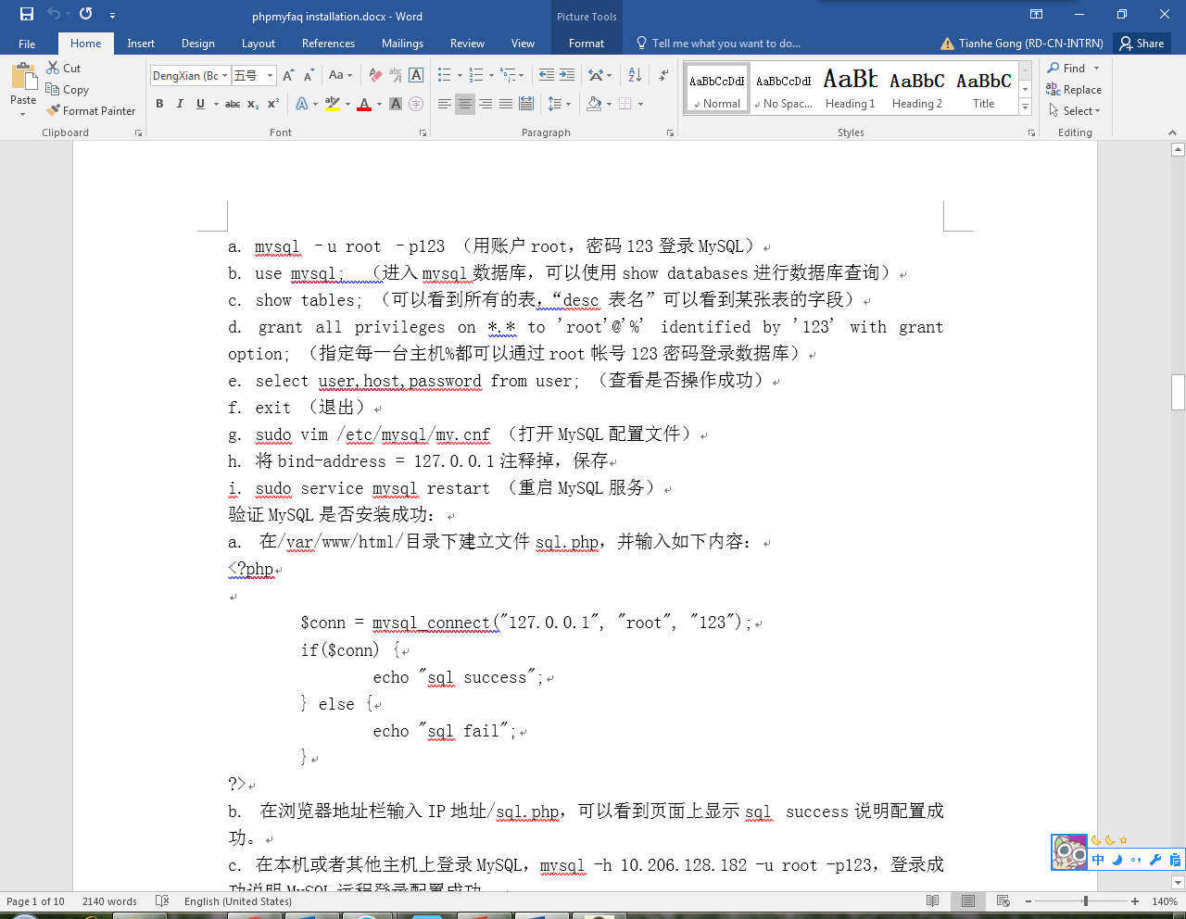
Configure and deploy phpMyFAQ
Finish the document of configuration and installation

Slide 6
Case Migration Tool Project
Feature enhancement: Migrate cases from TestRail to SCTM
1. front-end style: multi-open accordion
2. product assignment
3. group assignment
4. simple authority management

Slide 7
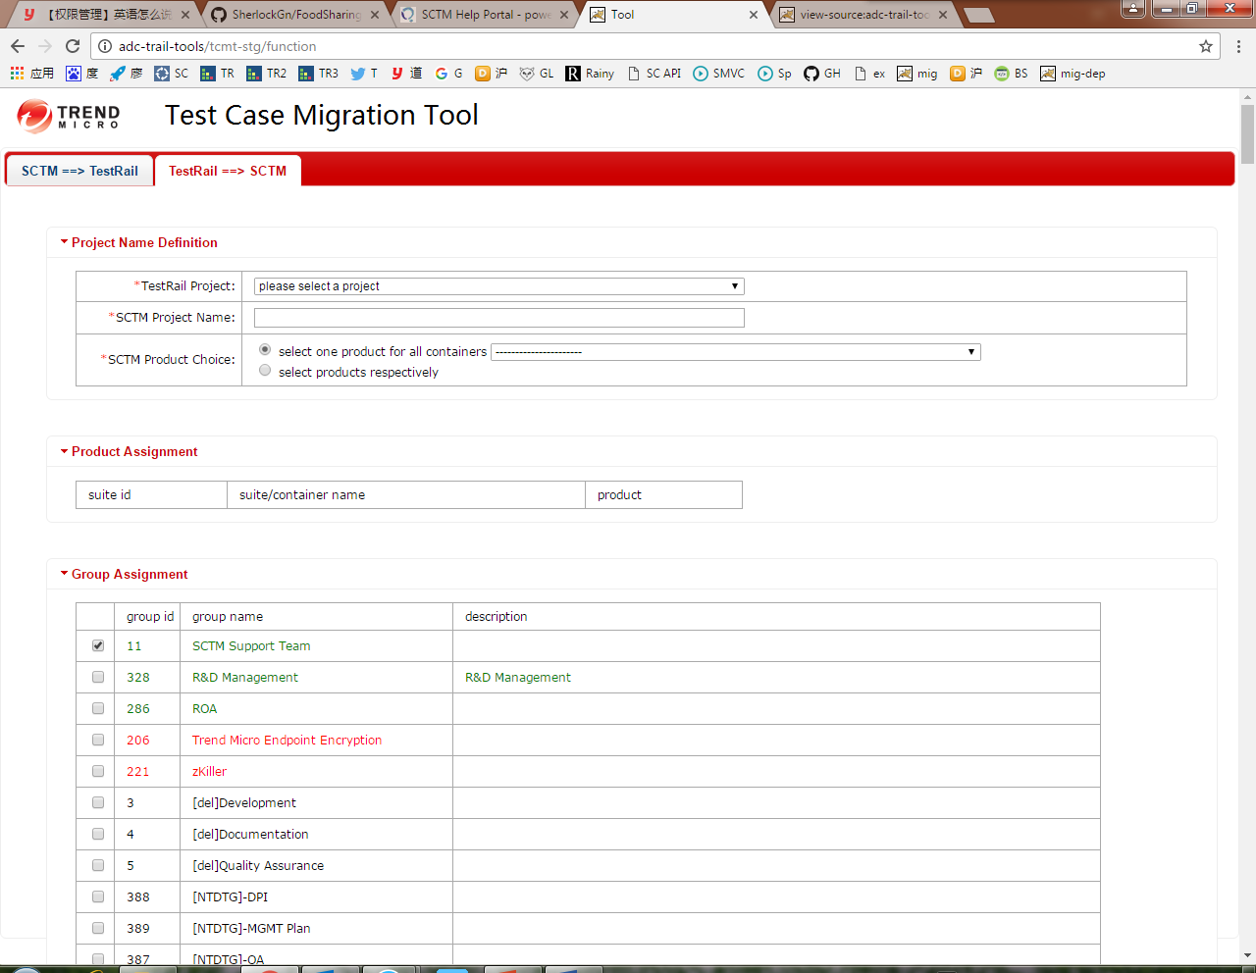
Case Migration Tool Project
Feature enhancement: Migrate cases from TestRail to SCTM

Slide 8
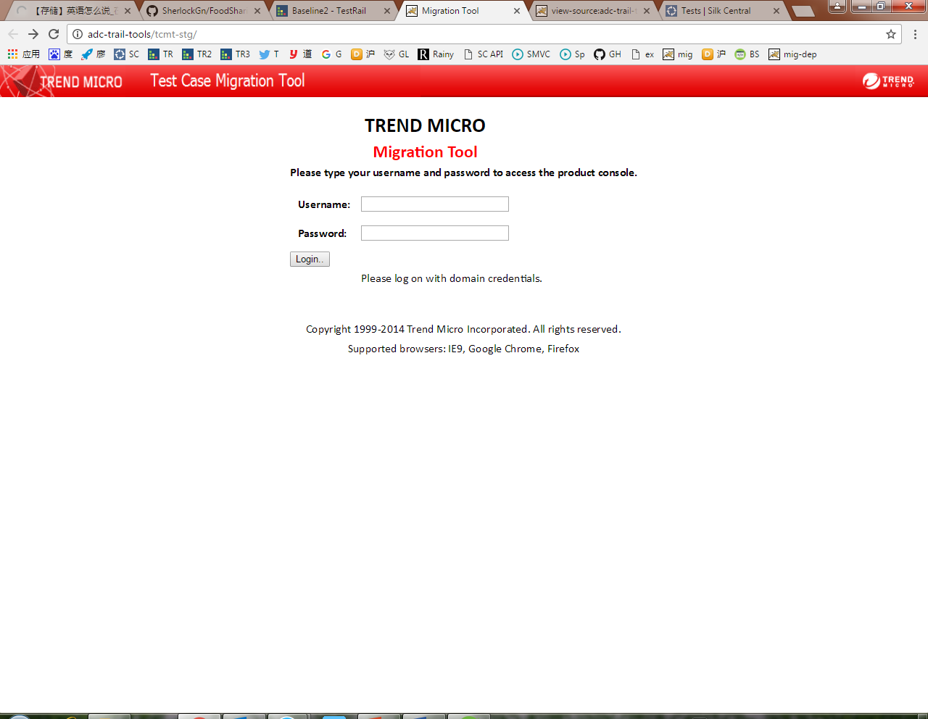
Case Migration Tool Project
Feature enhancement: Login/Logout of users
1. offer a login page to identify users
2. information of users are stored in cookie
3. authentication is judged by TestRail API

Slide 9
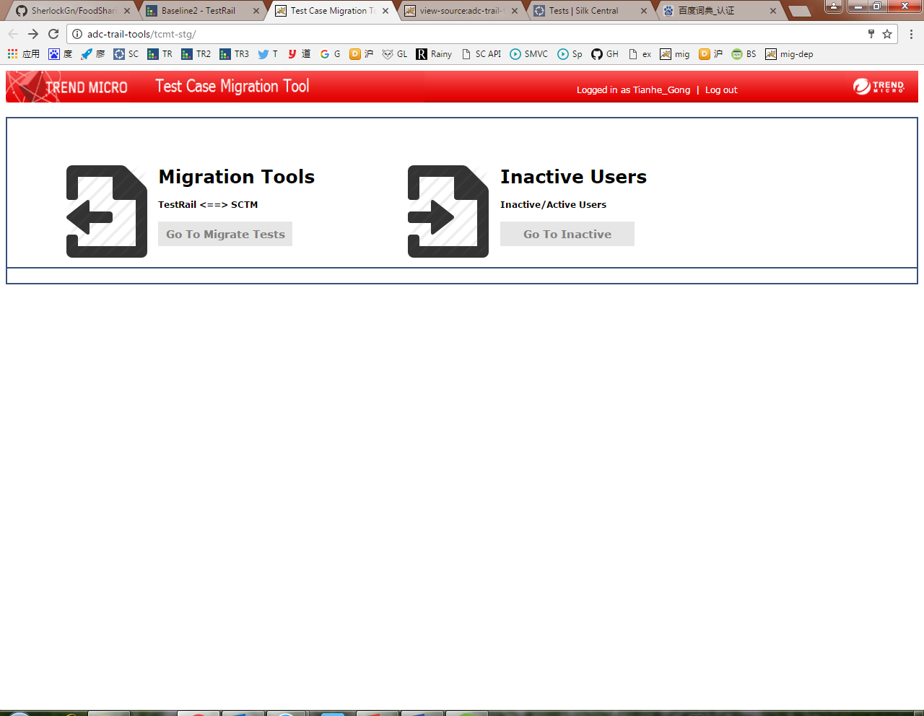
Case Migration Tool Project
Feature enhancement: Branch page
users can choose which projects to access

Slide 10
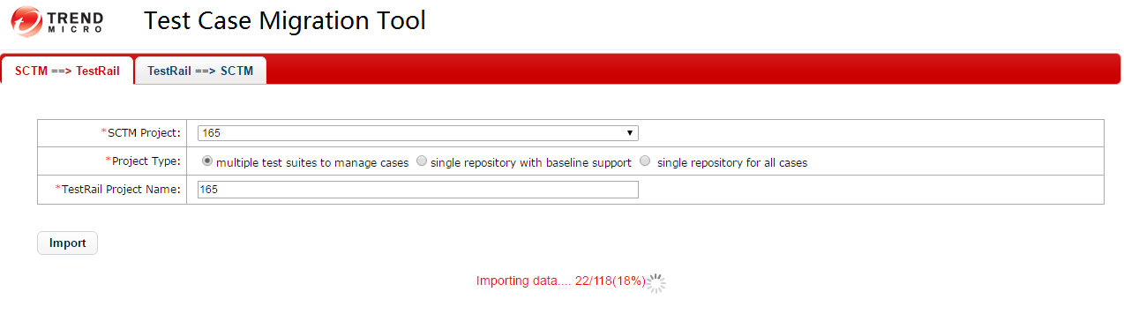
Case Migration Tool Project
Feature enhancement: Progress hint when migrating cases

Slide 11
Case Migration Tool Project
Bug modification: Migrate cases from SCTM to TestRail
loss of cases when migrating may be caused by
1. the sequence of storage
2. some cases are linked to suites/containers directly
3. dirty data
Bugs are solved by
1. a queue is used to store nodes whose fathers are not discovered
2. a section/folder called “default section” is created in multi-suite mode

Slide 12
Case Migration Tool Project
Performance improvement
Multi-threads are adopted when migrating cases.
Reading times is decreased as many as possible when accessing database.
Data structure is optimized. (Hash maps are adopted instead of lists)

Slide 13
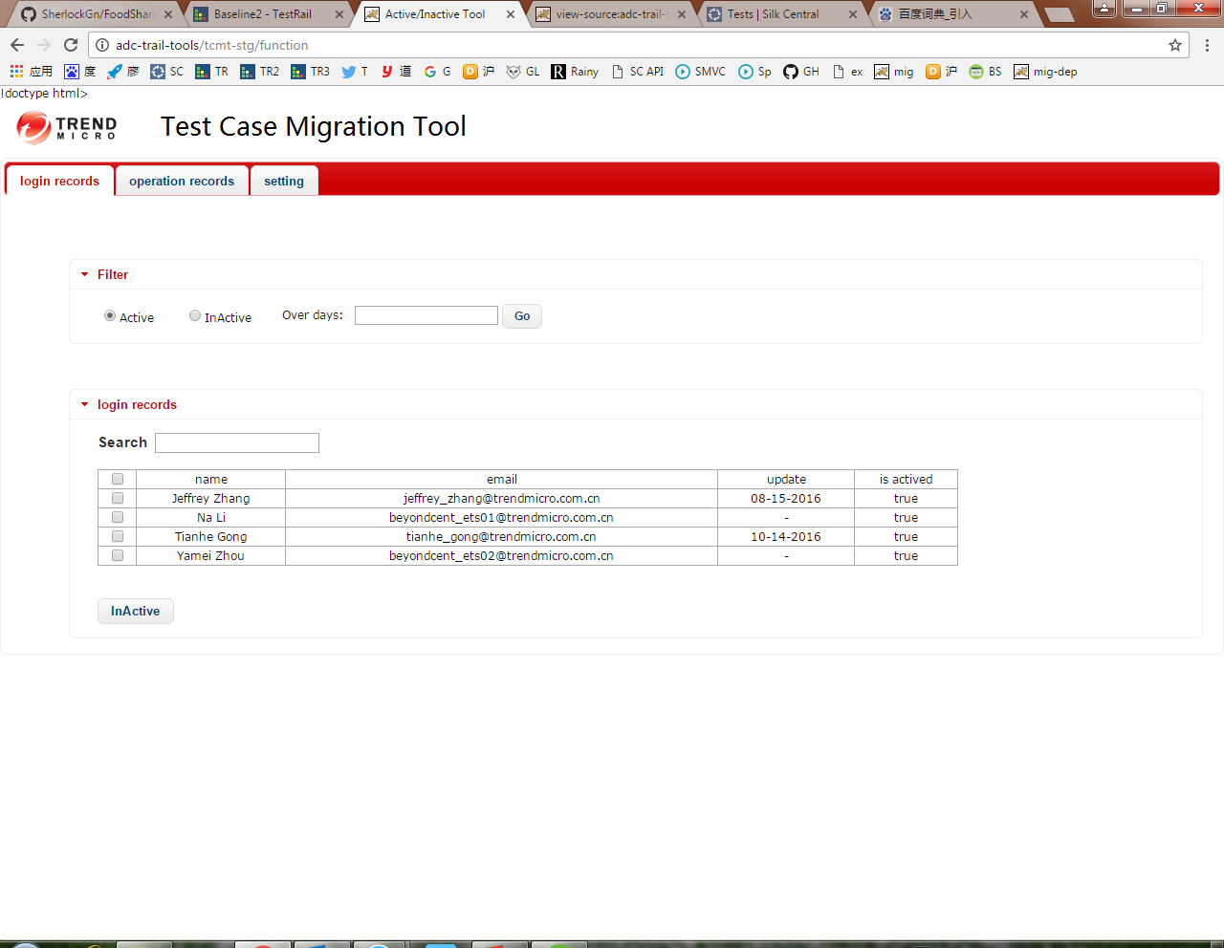
Active/Inactive Users Tool Project
Front-end improvement
1. Modify front-end framework (JQuery-UI instead of Bootstrap)
2. Accordion format is unified

Slide 14
Active/Inactive Users Tool Project
Back-end improvement
1. Introduce SSM framework
2. Improve auto-inactive thread

Slide 15
Write project documents
The documents of Migration Tool & Inactive/Active Tool is written detailedly.
Documents include:
1. User Guidance
2. Web Design
3. Business Logic

Slide 16
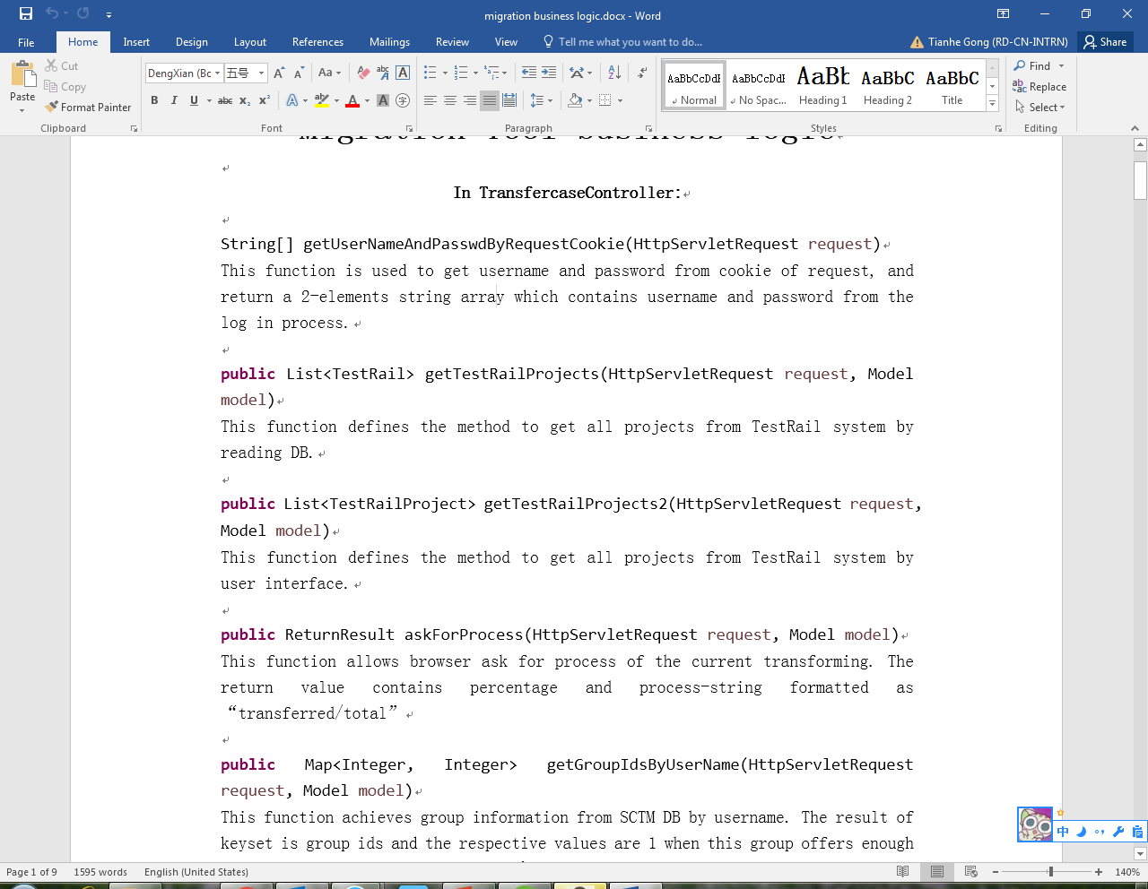
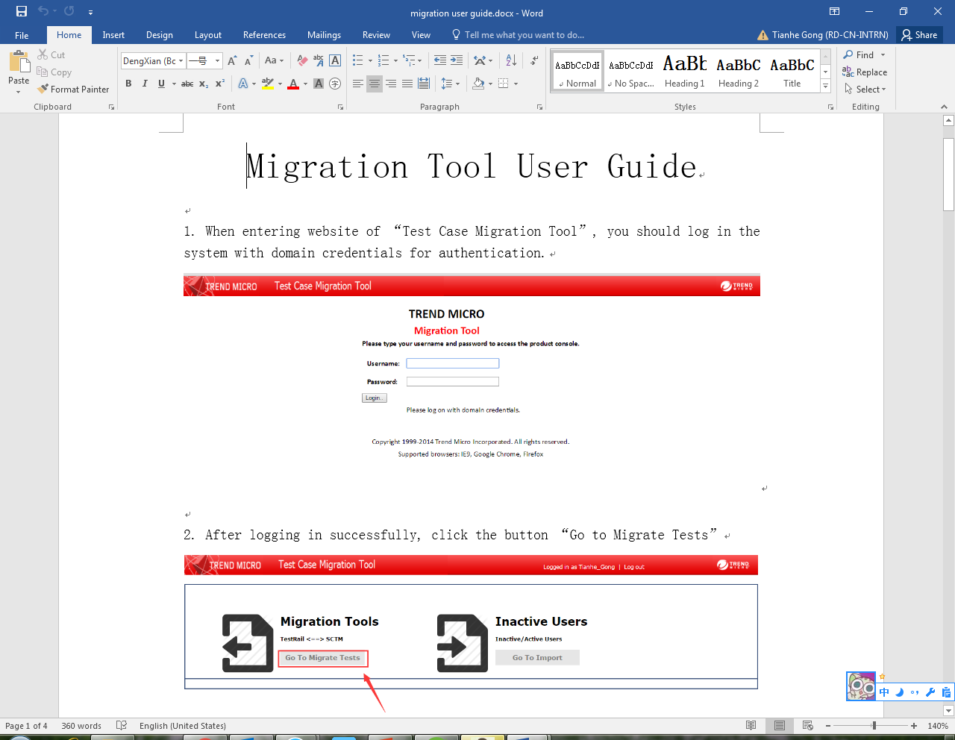
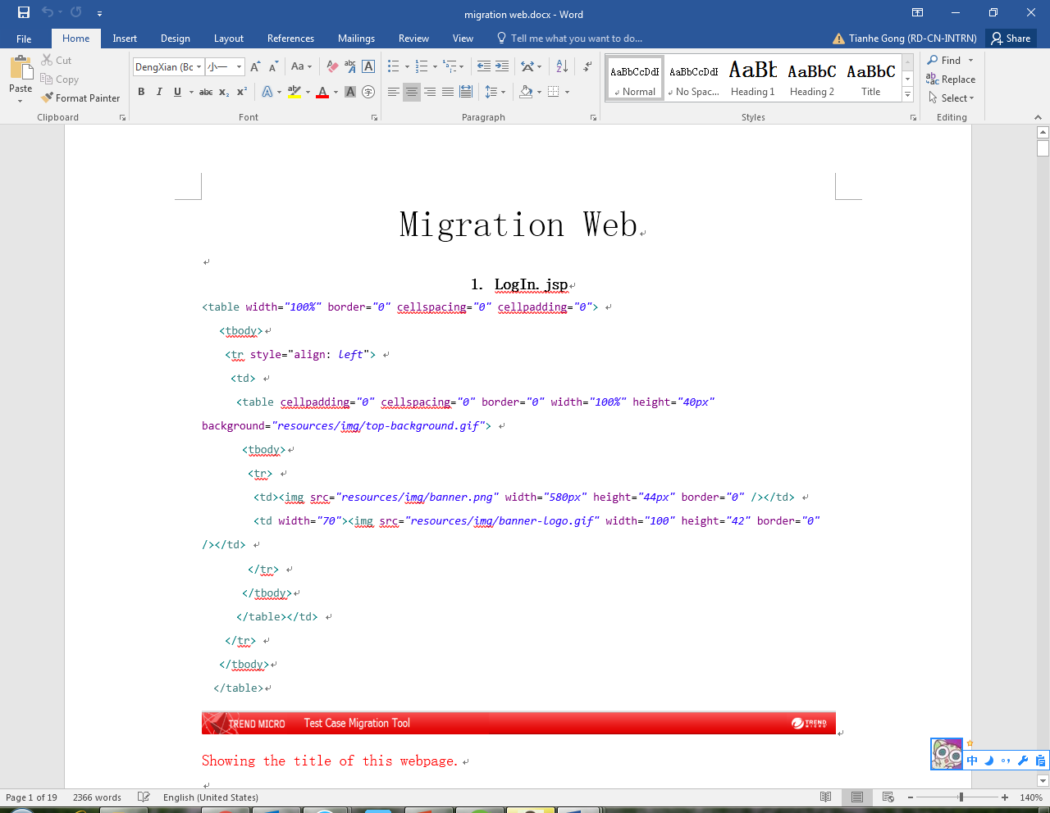
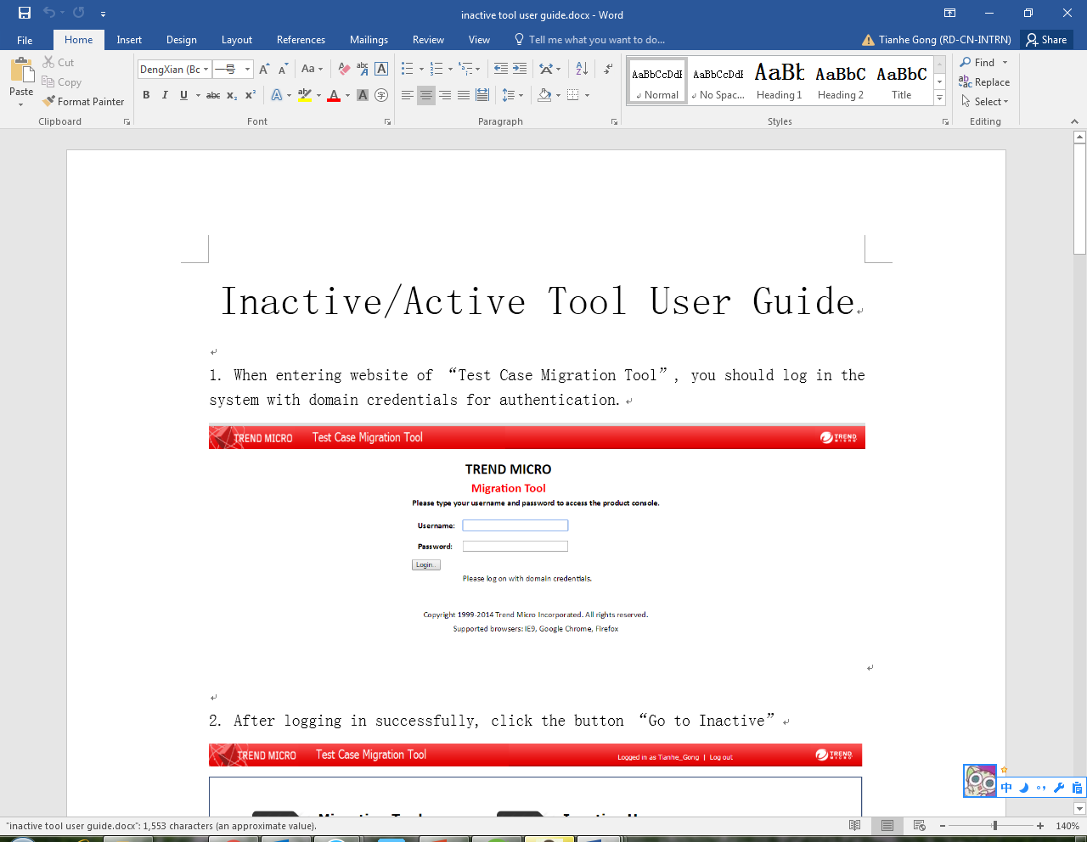
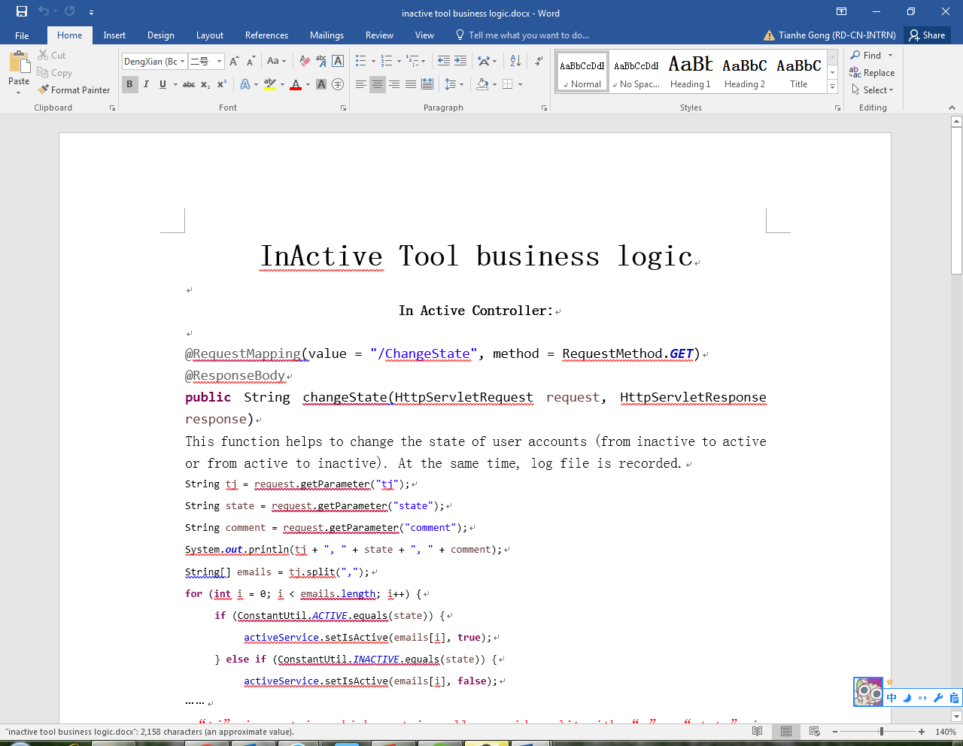
Write project documents

Slide 17
PPT of TestRail Introduction
A PPT about TestRail introduction is written from all aspects
1. Why choose TestRail
2. User management
3. Suite/Section/Case management & automation Test

Slide 18
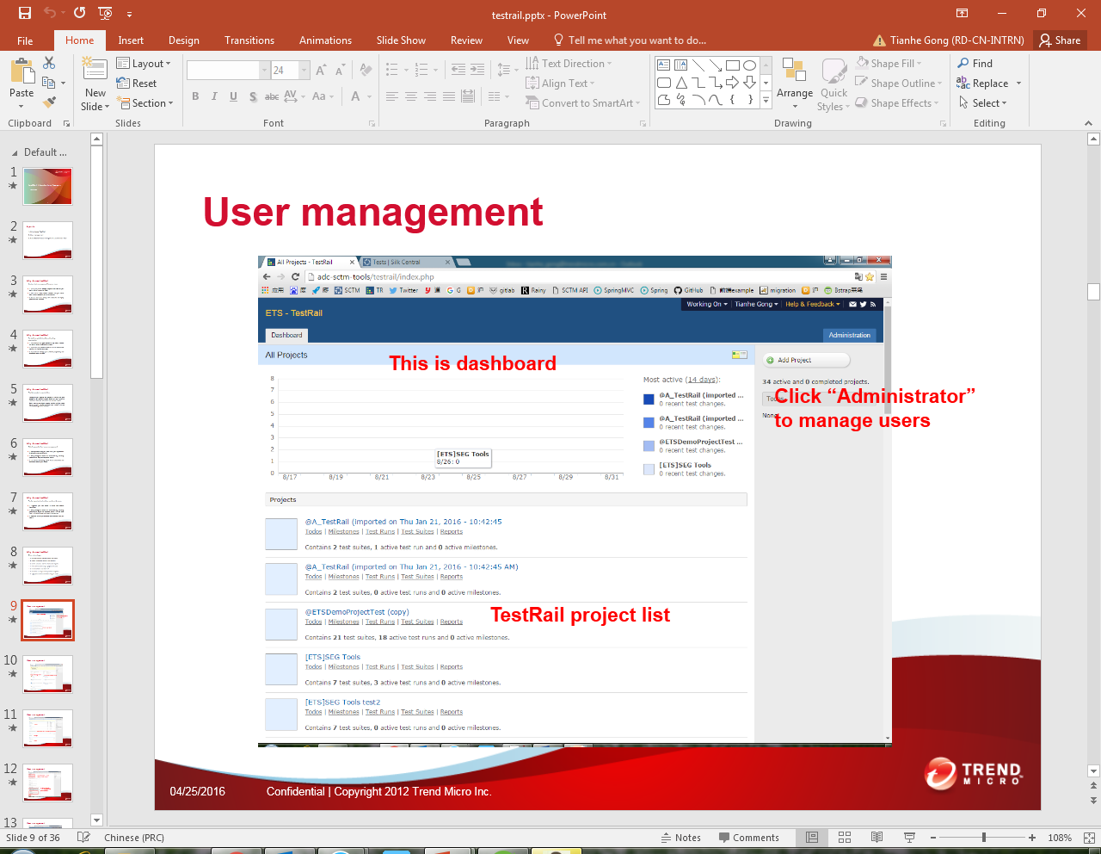
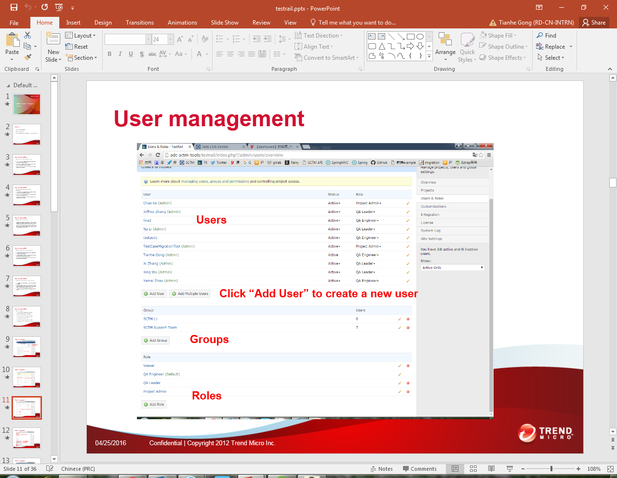
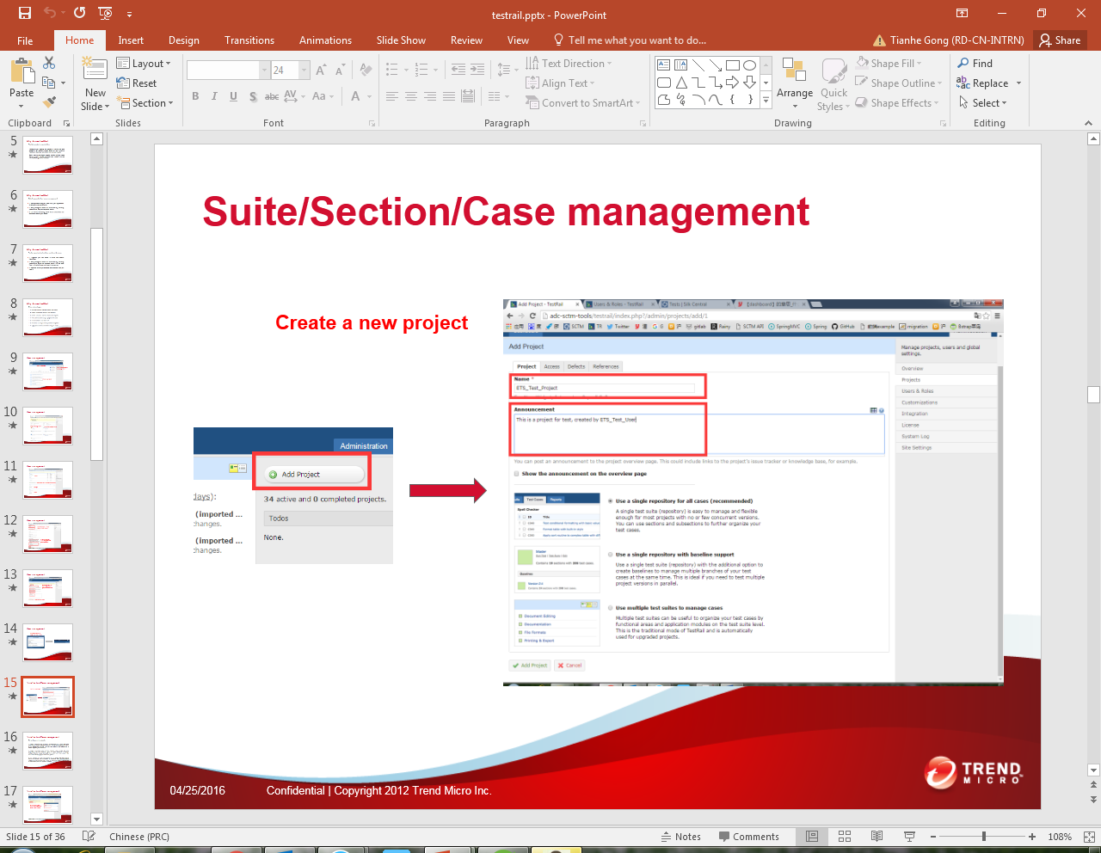
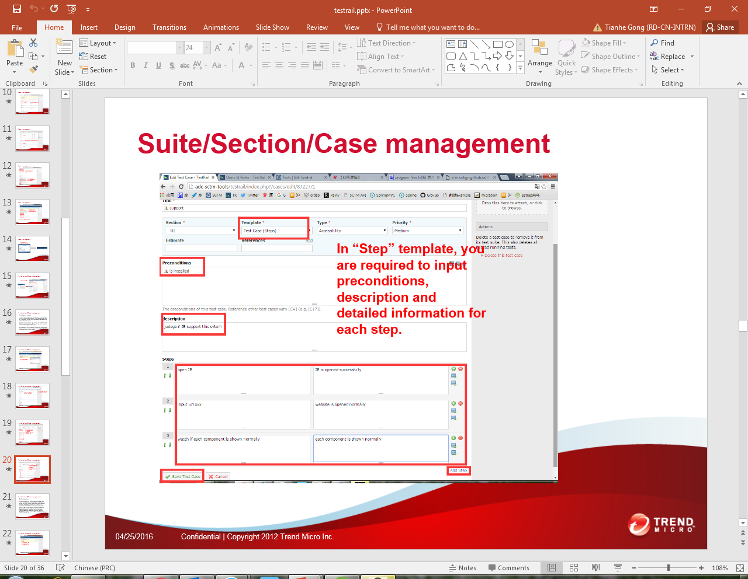
PPT of TestRail Introduction

Slide 19
Thank you
All documents can be accessed by the following files:
——About phpMyFAQ
1. phpmyfaq installation.docx
——About Migration Tool
1. migration business logic.docx
2. migration user guide.docx
3. migration web.docx

Slide 20
Thank you
All documents can be accessed by the following files:
——About Inactive Tool
1. inactive tool business logic.docx
2. inactive tool user guide.docx
——About TestRail Introduction
1. testrail.pptx
2. TestRail.docx

